Slide 1

BUSINESS ANALYTICS CLUB
Workshop Series 10.24
Excel Visual Basics for Applications
Janet Ye

Slide 2
Learning Objective
Learn sample tasks in Excel VBA to clean a large dataset for analysis in other programming languages
Data Type
Object Hierarchy
Functions
Powerful to to data cleaning
Microsoft Corporate VP, 10/26
Credit Suisse, Big Data, 11/3
Registration / Office hour, 11/5
Digital Reasoning, detecting fraud +/ terrorism, 11/12

Slide 3
Data Type
Types of Data in Excel
Name of city: New York (words)
Length of West 4th Street: 2.00 (decimal)
Population: 8,500,000 (integer)
MetroCard fare: 2.75 (currency)
Workshop location: “Tisch Hall” (string)
Pass/Fail: false (boolean)
Average grade: 95.7 (double)
Food Rating: A (character)

Slide 4
Excel Hierarchy
Cell (“A1”)
Row / Column (1 / “A”)
Worksheet
Workbook
Notes:
From top to bottom
Cell(“A1”)
Row / Column (1 / “A”)
Worksheet(“Sheet1”)
Workbook (“Data.xls”)

Slide 5
Sample Use Cases
When user selects certain cells to run: modules
User runs the code the tally all numbers
User runs the code to form a table from entries
2 Types:
Subroutine: code that perform a set of actions / calculations. Does not return values
Function: like subroutine, but returns a value
When action is performed within the entire workbook/worksheet
Code is run when the workbook is opened or modified, etc.

Slide 6
Running VBA Codes
Programs updates automatically
No need to “compile” as we would need to in other programming languages
No undoing once programs are run and make changes
You should save the file before running the code
OR, sometimes make a duplicate of the file to run the code on

Slide 7
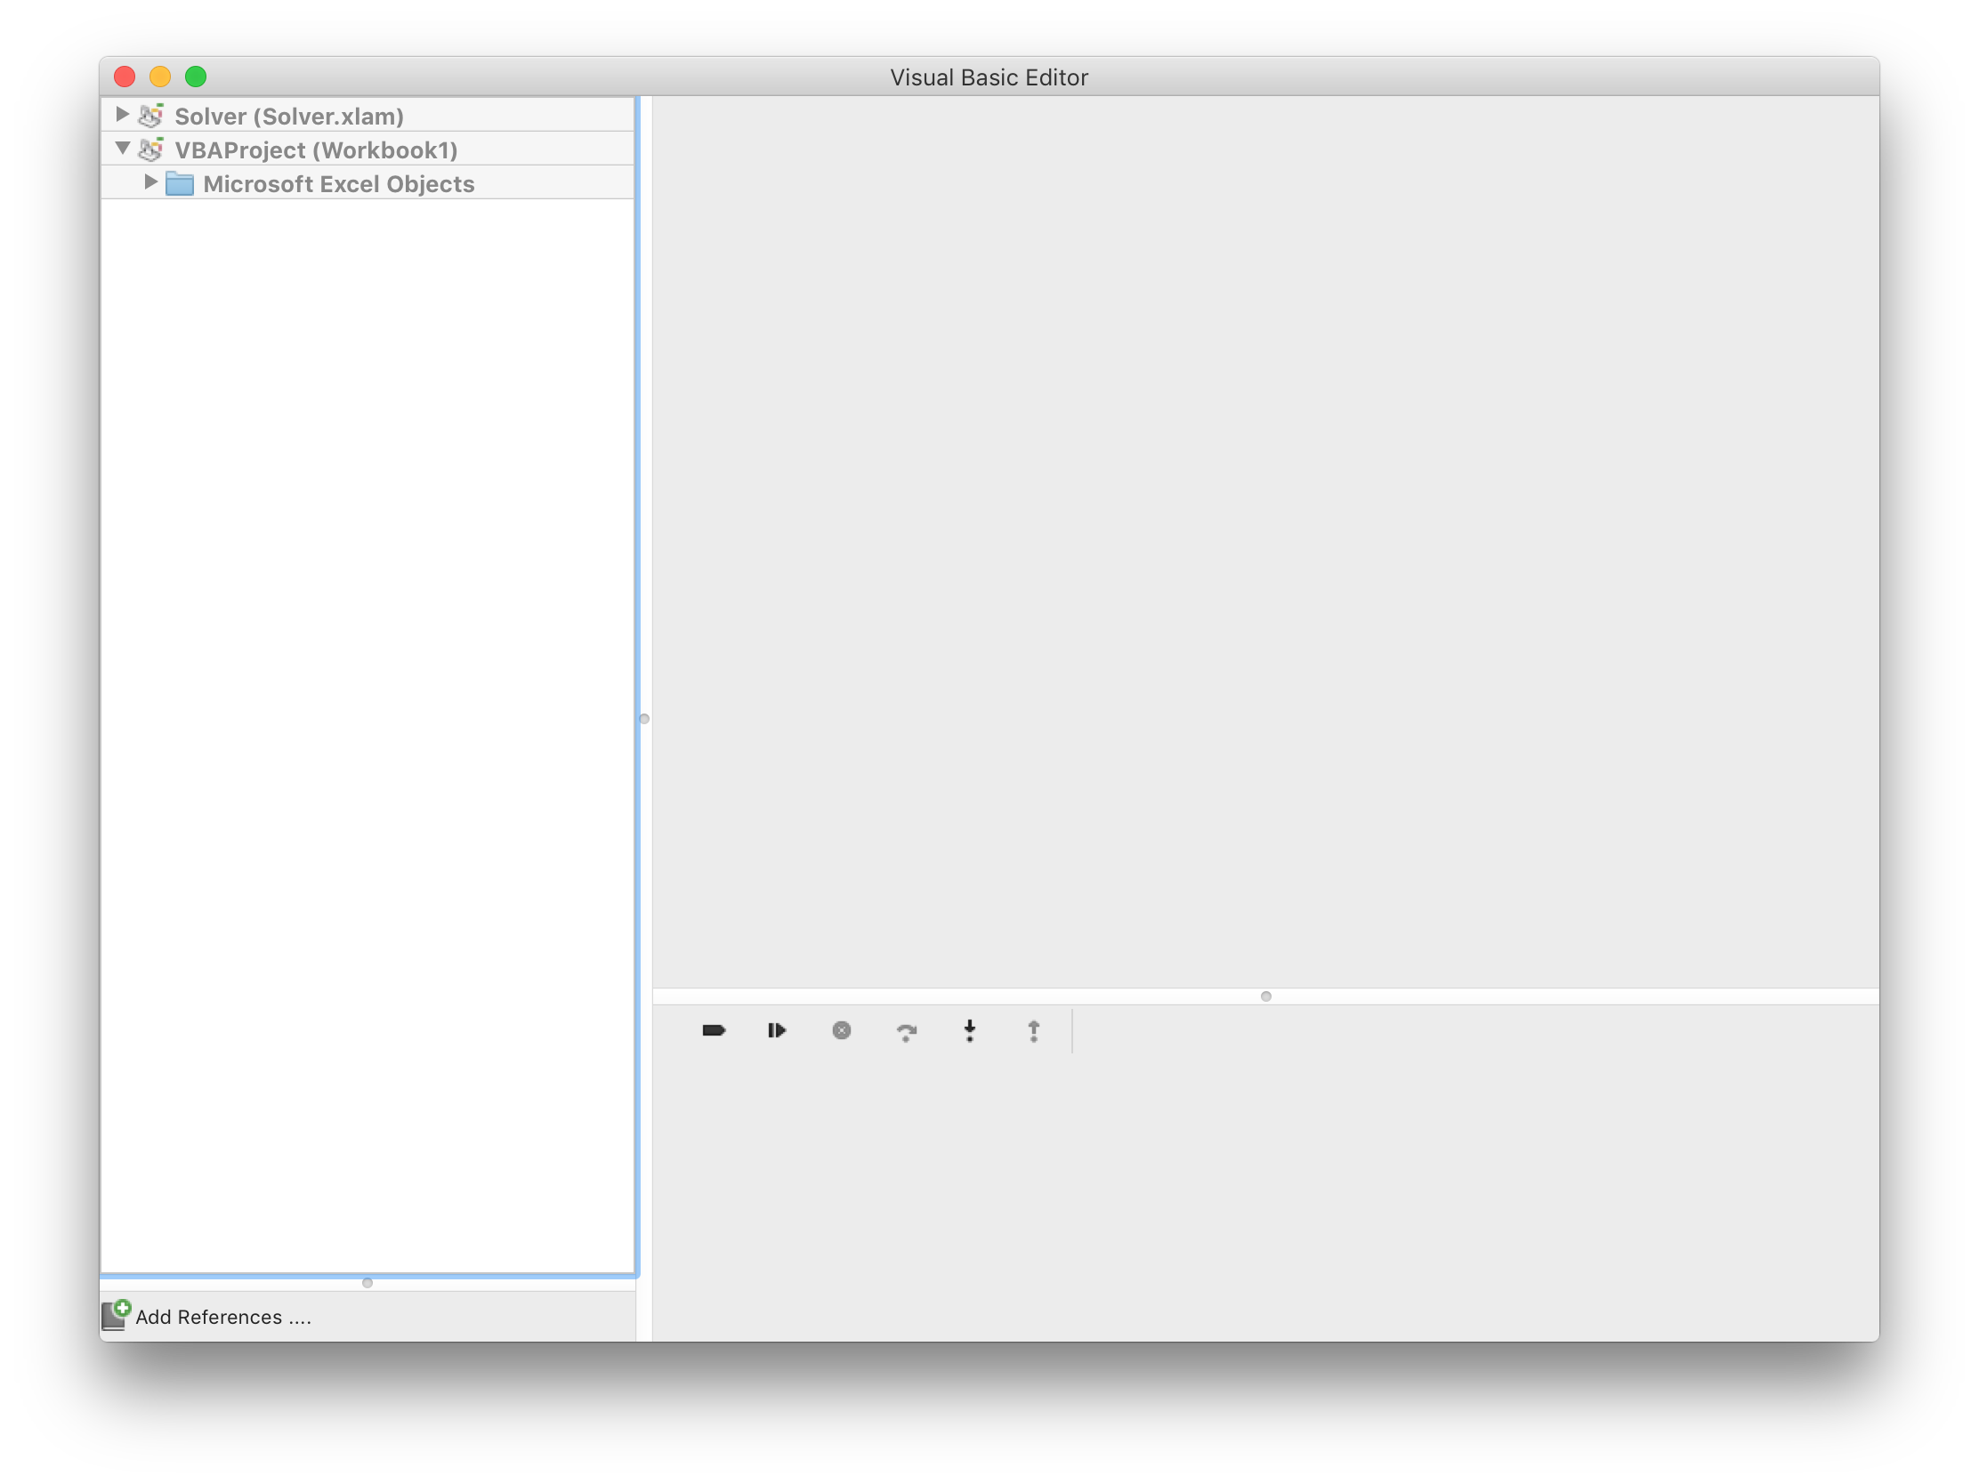
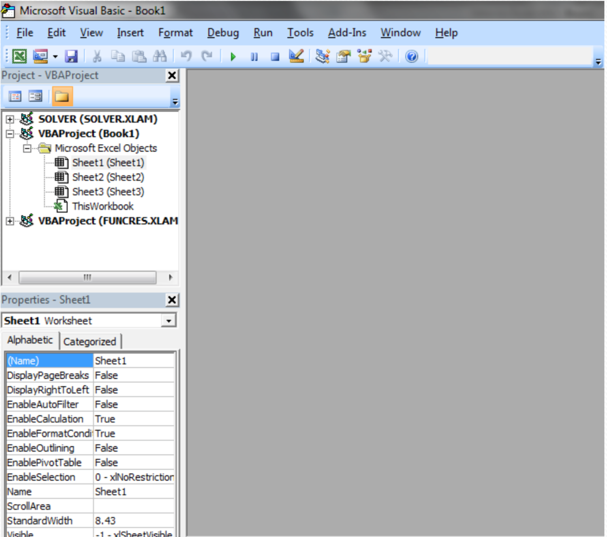
Launching VBA
PC
Mac
ALT + F11
Tool -> Macro -> Visual Basic Editor

Slide 8
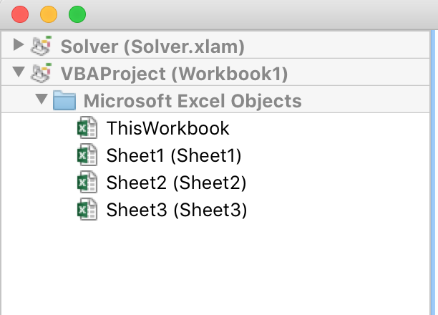
Microsoft Excel Objects
Each sheet has been set by default as an object
Sheet1 (Sheet1)
Sheet2 (Sheet2)
Sheet3 (Sheet3)
The workbook is also an object
Code should be written in the respective object that you want the actions top be performed

Slide 9
VBA-pardy
100
200
300
400
500
600
700
800

Slide 10
Rules
The teams will be made up of Left and Right halves of the room. Think of a team name!
Objective is to score as many points as possible.
The problem / point value will be projected.
First team to post a correct answer to the problem on the BAC facebook wall wins: www.facebook.com/SternBAC (specify your team name)
Team with the winning points will receive a mysterious prize

Slide 11
Function Example

Slide 12
Function Example
Task: given three digits a, b, c, and return the number abc
For example: 4, 5, 6 are passed, function returns 456
Calculation: 100 x a + 10 x b + c
Call this function concat
Module OR entire worksheet?

Slide 13
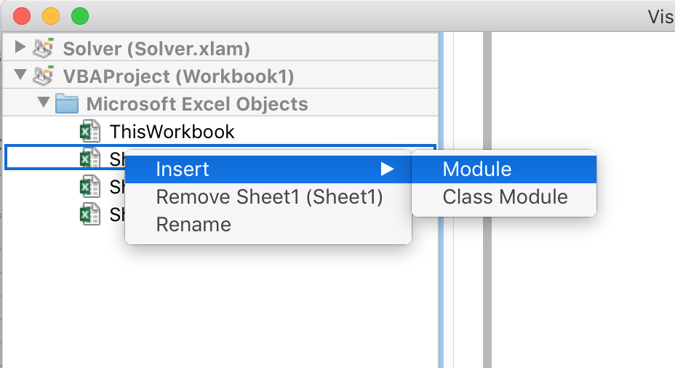
Create a Module
Right Click Sheet -> Insert -> Module

Slide 14
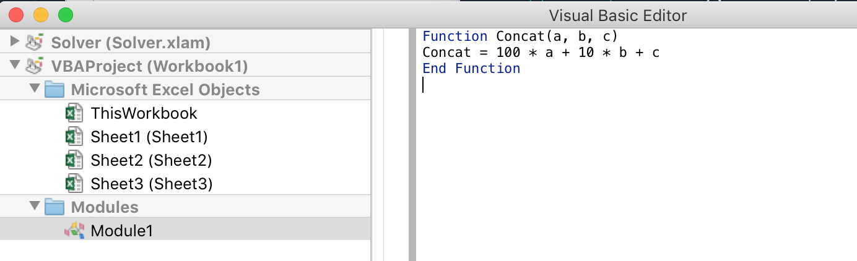
Create a Module
Function Concat(a,b,c)
Concat = 100 * a + 10 * b + c
End Function

Slide 15
Boolean Example

Slide 16
Coachella Game
Are these band names Real or Fake?
Gold Panda
Petting Zoo
Evil Needle
Barilla Penne
Bugseed
Real
Fake
Real
Fake
Real

Slide 17
Boolean Example
Boolean returns whether statement is True or False.
Is cell A1 equal to cell A2?
Is A greater than 5 times B?
Is 10 times A1 not equal to
one fifth of A2?
= A1 = A2
= A1 > (A2*5)
= (A1 * 10) <> (A2 / 5)

Slide 18
Loop Example

Slide 19
Loop Example
Let’s print 1, 2, …, 20 in columna A of the first 20 rows.
A1 / Cell (1,1) = 1
A2 / Cell (2,1) = 2
A3 / Cell (3,1) = 3
...
A20 / Cell (20,1) = 20

Slide 20
For Loop
Sub fillmein()
For Row = 1 To 20
Cells(Row, 1) = Row
Next Row
End Sub
Recall, there is no values to return. We are writing a subroutine, which is just a generic routine – in this case, fill in the first 20 rows with values.
Common Mistakes: Cells not Cell. Don’t forget Next Row, and End Sub

Slide 21
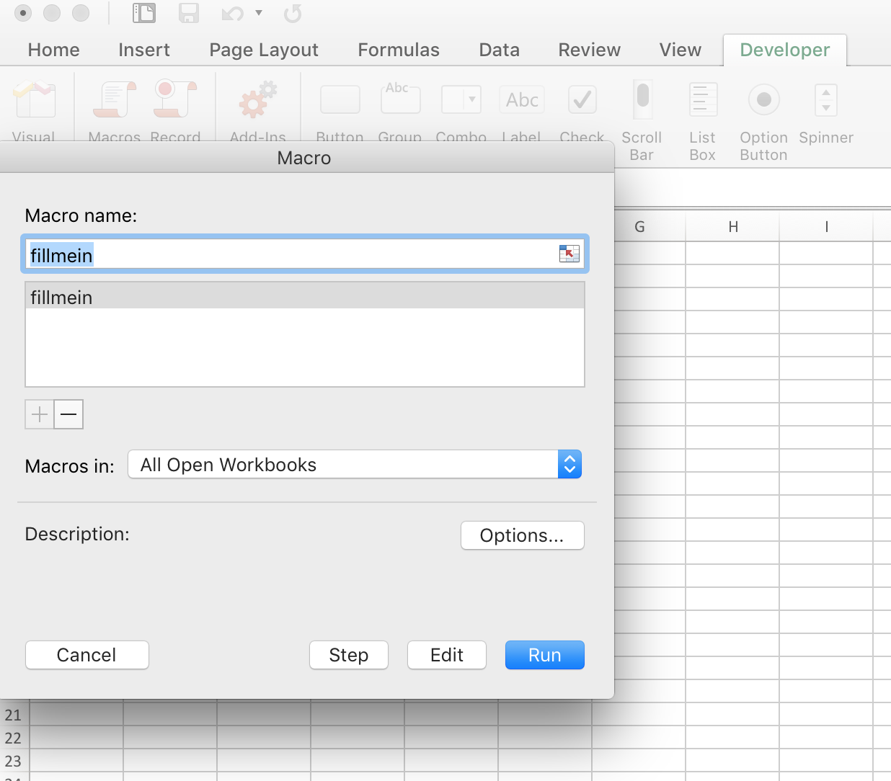
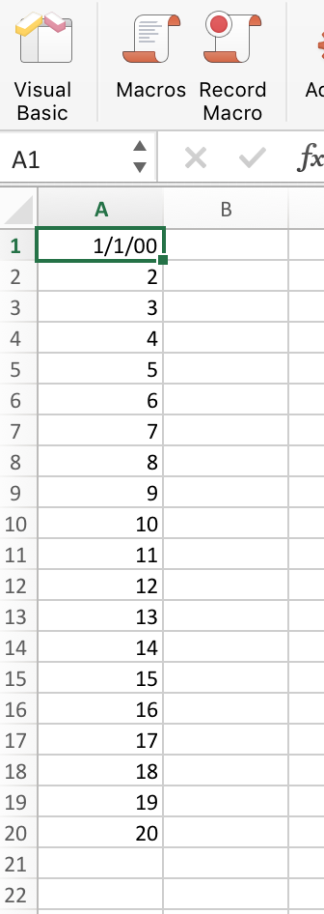
For Loop
To run the script, [Developer] tab -> [Macro] -> [fillmein] -> [run]

Slide 22
While Loop
Sub whilefillmein()
Row = 1
While Row <= 20
Cells(Row, 1) = Row
Row = Row + 1
Wend
End Sub
Key Difference: in For loop, we use Next Row to increment.
In While loop, we have to manually increment by calling Row = Row + 1

Slide 23
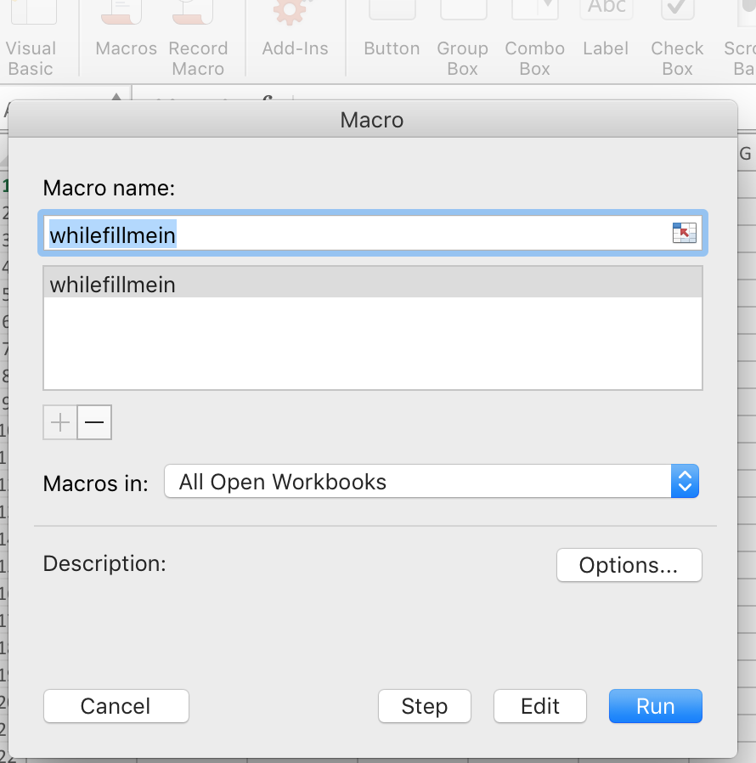
While Loop
To run the script, [Developer] tab -> [Macro] -> [fillmein] -> [run]

Slide 24
Tying everything together

Slide 25
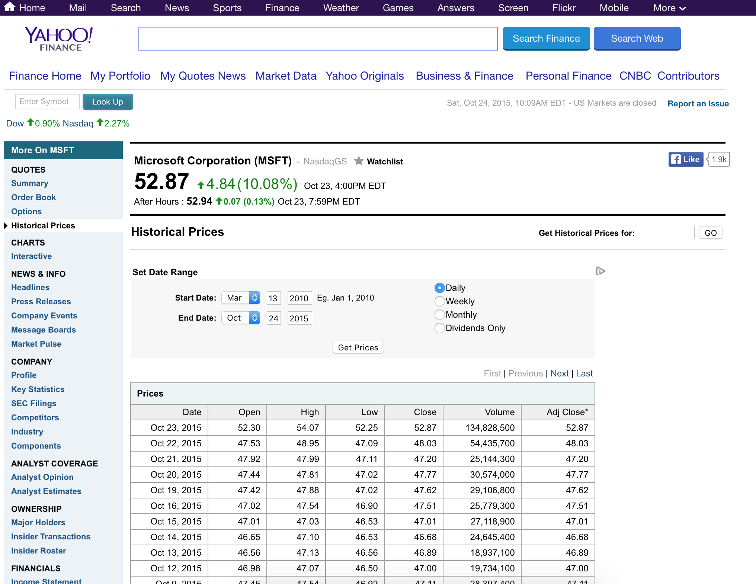
Simple Trading Buy/Sell Signal
Microsoft Stock Price from Yahoo Finance

Slide 26
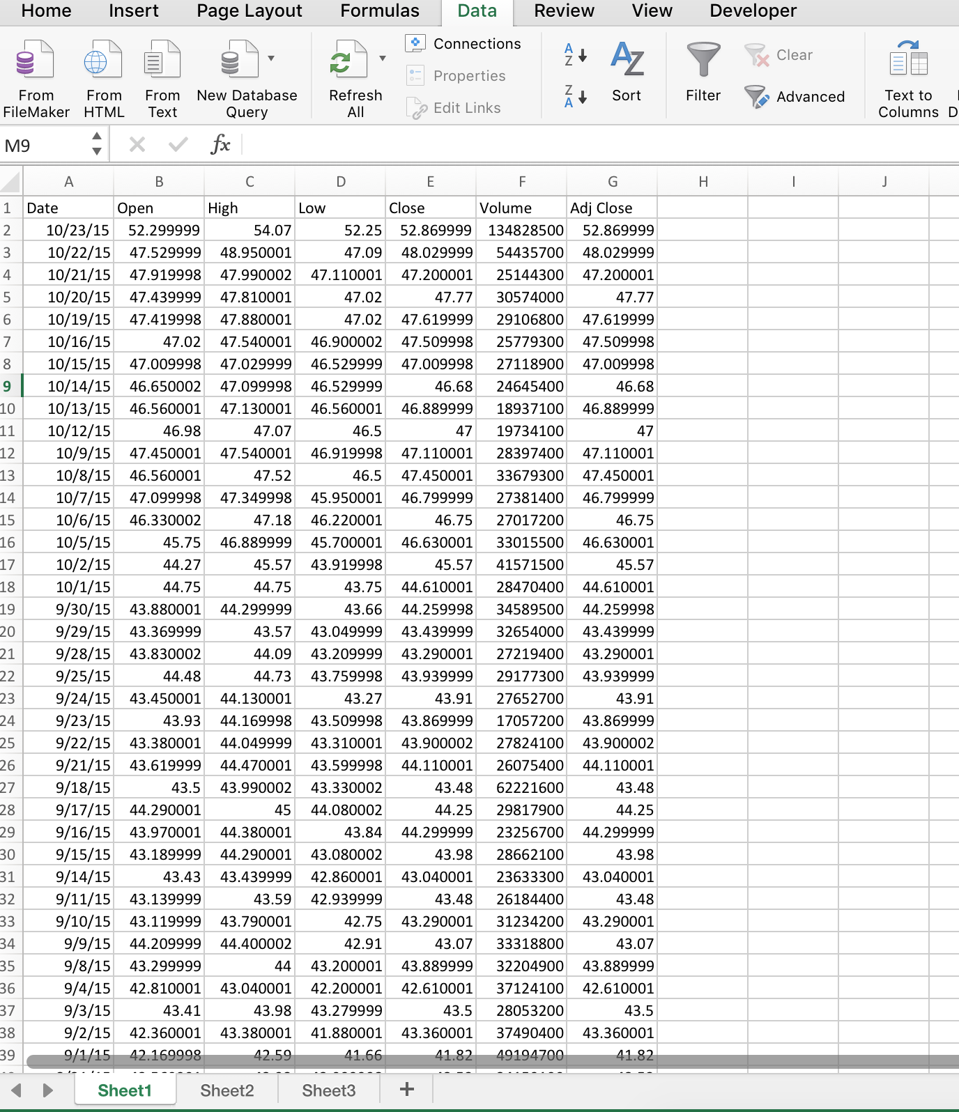
Paste into Excel, Text to Column

Slide 27
Use While Loop to Calculate Return
Daily Return = (Close – Open) / Open
Fill in Column H with Return
Sub buysellsignal()
return_col = 8
Cells(1,return_col) = “Return”
Row = 2 ‘first row is title
While Cells(Row, 2) <> “”
Cells(Row, return_col) = (Cells(Row, 5)-Cells(Row, 2))/(Cells(Row,2))
Row = Row + 1
Wend
End Sub

Slide 28
Three Day Moving Average
Average of three days’ returns. New code highlighted below.
Sub buysellsignal()
Cells(1, 8) = "Return"
Cells(1, 9) = "3D MA"
return_col = 8
three_day_ma_col = 9
Row = 2 'first row is title
While Cells(Row, 2) <> ""
Cells(Row, return_col) = (Cells(Row, 5) - Cells(Row, 2)) / (Cells(Row, 2))
If (Cells(Row + 1, return_col) <> "") And (Cells(Row + 2, return_col) <> "") Then
Cells(Row, three_day_ma_col) = (Cells(Row, return_col) + Cells(Row + 1, return_col) + Cells(Row + 2, return_col)) / 3
End If
Row = Row + 1
Wend
End Sub

Slide 29
VBA is a Powerful Tool
This is just a toy example.
VBA is capable of doing so much more, such as:
Cleaning data
Updating spreadsheet every time it’s opened or modified

